Slide 1

Predictive Analytics using R topic :- Time series analysis of Apple Inc. (AAPL) stock
BCU SCHOOL OF MANAGEMENT STUDIES
Presented by :- PRAFUL

Slide 2
Time Series
A time series is a sequence of data points collected over time, used to understand patterns and trends, forecast future values, and make decisions.

Slide 3
Objectives
The objective of this script is to conduct time series analysis and forecasting for Apple stock data over the last 5 years. It includes steps such as fetching the data, plotting closing prices, decomposing the time series, fitting an ARIMA model, and forecasting future stock prices.

Slide 4
Data source
The script fetches historical stock data for Apple (AAPL) from Yahoo Finance for the period from January 1, 2019, to January 1, 2024.
Yahoo Finance

Slide 5
Functions used
Quantmod:- Used to fetch stock data from Yahoo Finance (getSymbols) and extract closing prices (Cl).
forecast:- (‘auto.arima’, ‘forecast’).
Tseries:- (‘ts’, ‘stl’, ‘acf’, ‘pacf’).
lubridate:-(‘ymd’, ‘decimal_date’).
Full forms:-
autocorrelation and partial autocorrelation functions (acf, pacf).
ARIMA: AutoRegressive Integrated Moving Average

Slide 6
Fetch Apple stock data for the last 5 years
> getSymbols("AAPL", src = "yahoo", from = "2019-01-01", to = "2024-01-01")
[1] "AAPL“
Explanation:-
"AAPL": This is the ticker symbol for Apple Inc. It's used to specify which stock data to retrieve. In this case, it fetches data for Apple.
src = "yahoo": This specifies the source from which the stock data will be fetched.
from = "2019-01-01": This specifies the start date from which the historical stock data will be fetched. Here, it's set to January 1, 2019, indicating that the data retrieval starts from this date.
to = "2024-01-01": This specifies the end date up to which the historical stock data will be fetched. Here, it's set to January 1, 2024, indicating that the data retrieval ends on this date.

Slide 7
Extract the closing prices
applestock <- Cl(AAPL)
Explanation:-
Cl(): This function is part of the quantmod package in R, It is specifically used to extract the closing prices of a stock from the data retrieved by getSymbols.
Applestock: closing prices of Apple stock

Slide 8
myts
myts <- ts(appleprices, start = decimal_date(ymd("2019-01-01")), frequency = 365.25
Explanation:-
frequency = 365.25: This parameter specifies the number of observations per unit time. Since the data is daily, the frequency is set to approximately 365.25

Slide 9
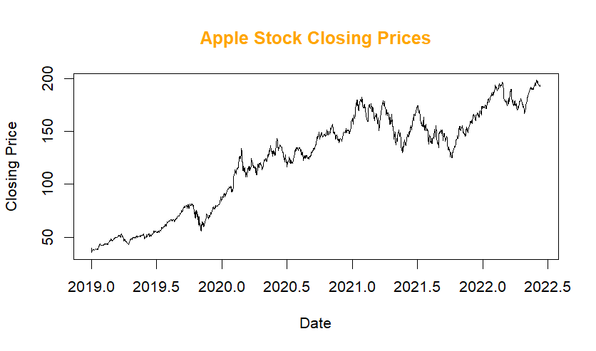
Plotting the closing prices
plot(myts, xlab ="Date", ylab ="Closing Price", main ="Apple Stock Closing Prices", col.main ="orange")

Slide 10
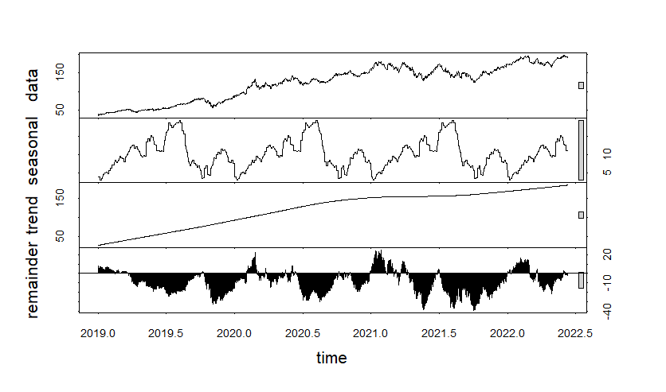
Time Series Decomposition
decomposed <- stl(myts, s.window = "periodic")plot(decomposed)

Slide 11
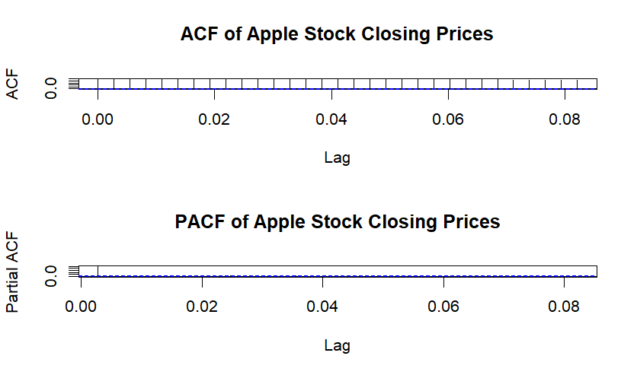
ACF and PACF plots
par(mfrow = c(2, 1))
acf(myts, main = "ACF of Apple Stock Closing Prices")pacf(myts, main = "PACF of Apple Stock Closing Prices")par(mfrow = c(1, 1))

Slide 12
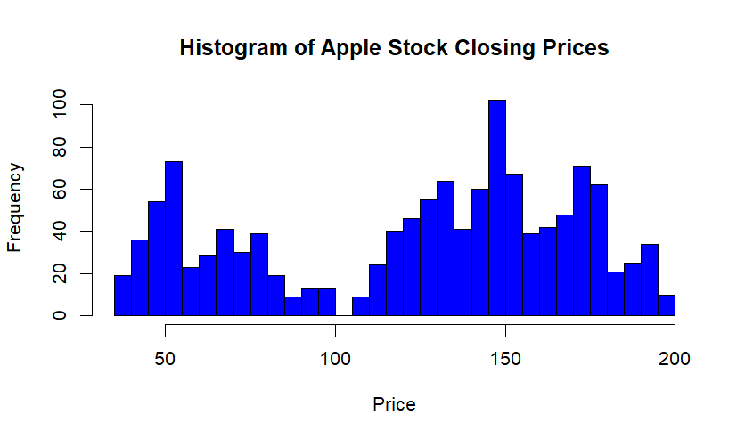
Histogram of the closing prices
hist(appleprices, breaks = 50, main = "Histogram of Apple Stock Closing Prices", xlab = "Price", col = "blue")

Slide 13
Fit an ARIMA model
model <- auto.arima(myts)
summary(model) Series:
myts
ARIMA(1,1,0) with drift Coefficients: ar1 drift -0.0423 0.1219 s.e. 0.0282 0.0647 sigma^2 = 5.723: log likelihood = -2879.07 AIC=5764.15 AICc=5764.17 BIC=5779.56 Training set error measures: ME RMSE MAE Training set -0.0001052027 2.389529 1.688985 MPE MAPE MASE Training set -0.01775869 1.421144 0.03789005 ACF1 Training set -0.001038176

Slide 14
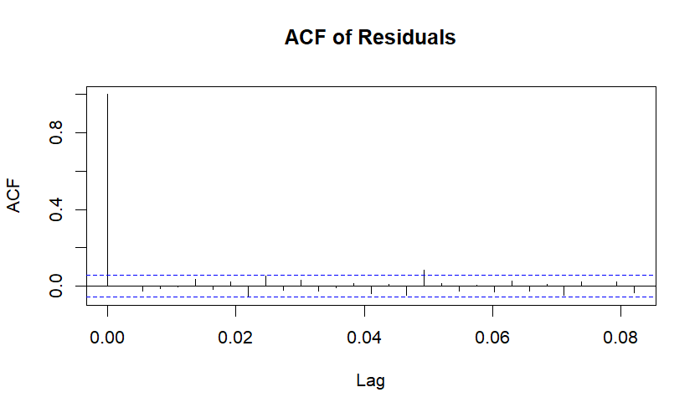
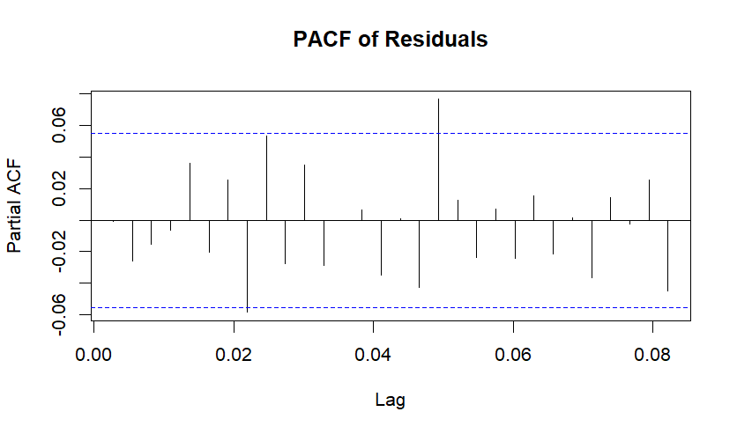
ACF and PACF of residuals
acf(model$residuals, main = "ACF of Residuals")
pacf(model$residuals, main = "PACF of Residuals")

Slide 15
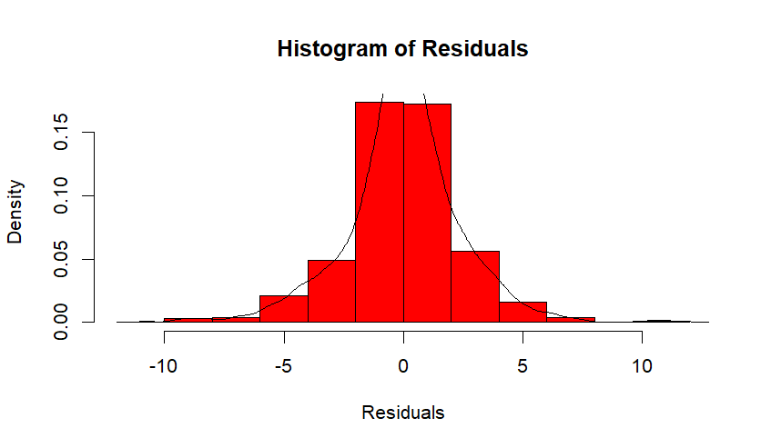
Histogram of residuals
hist(model$residuals, col = "red", xlab = "Residuals", main = "Histogram of Residuals", freq = FALSE)
> lines(density(model$residuals))
explanation:-In this case, the histogram appears to be roughly bell-shaped, which suggests that the residuals may be normally distributed.

Slide 16
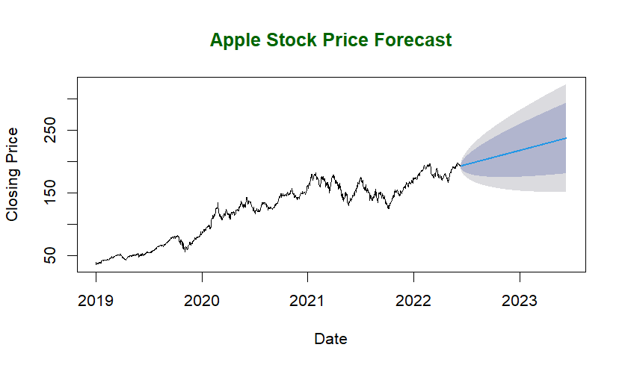
Forecasting the next 12 months
forecasted <- forecast(model, h = 365)plot(forecasted, xlab = "Date", ylab = "Closing Price", main = "Apple Stock Price Forecast", col.main = "darkgreen")

Slide 17
INTERPRETATION
It visualizes the closing prices, decomposes the time series, fits an ARIMA model, and forecasts future stock prices. Finally, the forecasted values suggest the expected trend of increasing in Apple stock prices fo the next 12 months.

Slide 18

THANK YOU

